Slide 1
DEPARTMENT OF CSE COURSE NAME – ADAPTIVE Software Engineering COURSE CODE – 22CI2001
Session-11
Topic:
Reviews & Walkthrough
&
SRS VS USER STORIES

Slide 2
AIM OF THE SESSION
To familiarize students with the basic concept Extreme Programming
To familiarize students with the basic concept of requirements documentations i.e. SRS and User stories
INSTRUCTIONAL OBJECTIVES
This Session is designed to:
Introduction to Reviews
List out Walk throughs
Describe peer reviews
Demonstrate Documenting the Requirements reporting
Describe SRS and its advantages and disadvantages
List out the Various features of good SRS
Describe the comparisons of SRS and User stories
LEARNING OUTCOMES
At the end of this session, you should be able to:
Define review
Describe the walk through
Summarize Practices
Define SRS and User stories
Describe Importance of SRS and User stories
Summarize Comparison of SRS and User stories

Slide 3
Peer reviews (Inspections and Walkthroughs)
Participants
Preparations
The FDR session
Post-review activities
Peer review coverage
Comparison of peer reviews methods
Expert opinions

Slide 4
Peer Reviews
Will discuss
1. inspections and
2. walkthroughs.
Difference between formal design reviews and peer reviews is really in both their participants and authority.
DRs: most participants hold superior positions to the project leaders and customer reps;
Peer reviews, we have equals
members of his/her department and other units.

Slide 5
Peer Reviews
Other major difference is
degree of authority and
objective of each review method.
FDRs: authorized to approved design doc
work can now continue in project.
Not granted in peer reviews
main objectives lie in
detecting errors and
deviations from standards.

Slide 6
Participants of Peer Reviews
Inspection
Walkthrough
Review leader
The author
Specialized professionals:
Designer
Coder or implementer
Tester
Review leader
The author
Specialized professionals:
Standards enforcer
Maintenance expert
User representative

Slide 7
Peer Reviews - more
7
Tendency nowadays: diminish the value of manual reviews such as inspections and reviews.
We don't have as many as we used to.
Largely due to agile approaches to development and concerns for time savings and streamlining the process wherever possible.
Empirical evidence, however, indicates convincing evidence that peer reviews are highly efficient and effective.

Slide 8
Peer Reviews: Inspections / Walk-Throughs
8
Walkthroughs and inspection differ in formality –
Inspections emphasize the objective of corrective action; more formal
Walkthroughs limited to comments on document reviewed.
Inspections also look to improve methods as well.
Inspections are considered to contribute more to general level of SQA.

Slide 9
Peer Reviews: Inspections
9
Inspections usually based on a comprehensive infrastructure:
Development of inspection checklists for each type of design document as well as coding languages, which are periodically updated.
Development of typical defect type frequency tables, based on past findings to direct inspectors to potential ‘defect concentration areas.’
Training of competent professionals in inspection process issues – making it possible for them to serve as inspection leaders (moderators) or inspection team members
Periodic analysis of the effectiveness of past inspections to improve the inspection methodology
Introduction of scheduled inspections into project activity plan and allocation of the required resources, including resources for corrections

Slide 10
Comparing the Two…
10
Organizations typically modify methods to local considerations.
Local protocols, team structure, etc. can be modified.
So, differences between the two can be easily blurred.
Some view one as the other; vice versa
Some argue that one is better than the other, and vice versa.
Research has indicated that walkthroughs discover far fewer defects found but at the same cost.
Likely this is due to some of the lost formalisms??

Slide 11
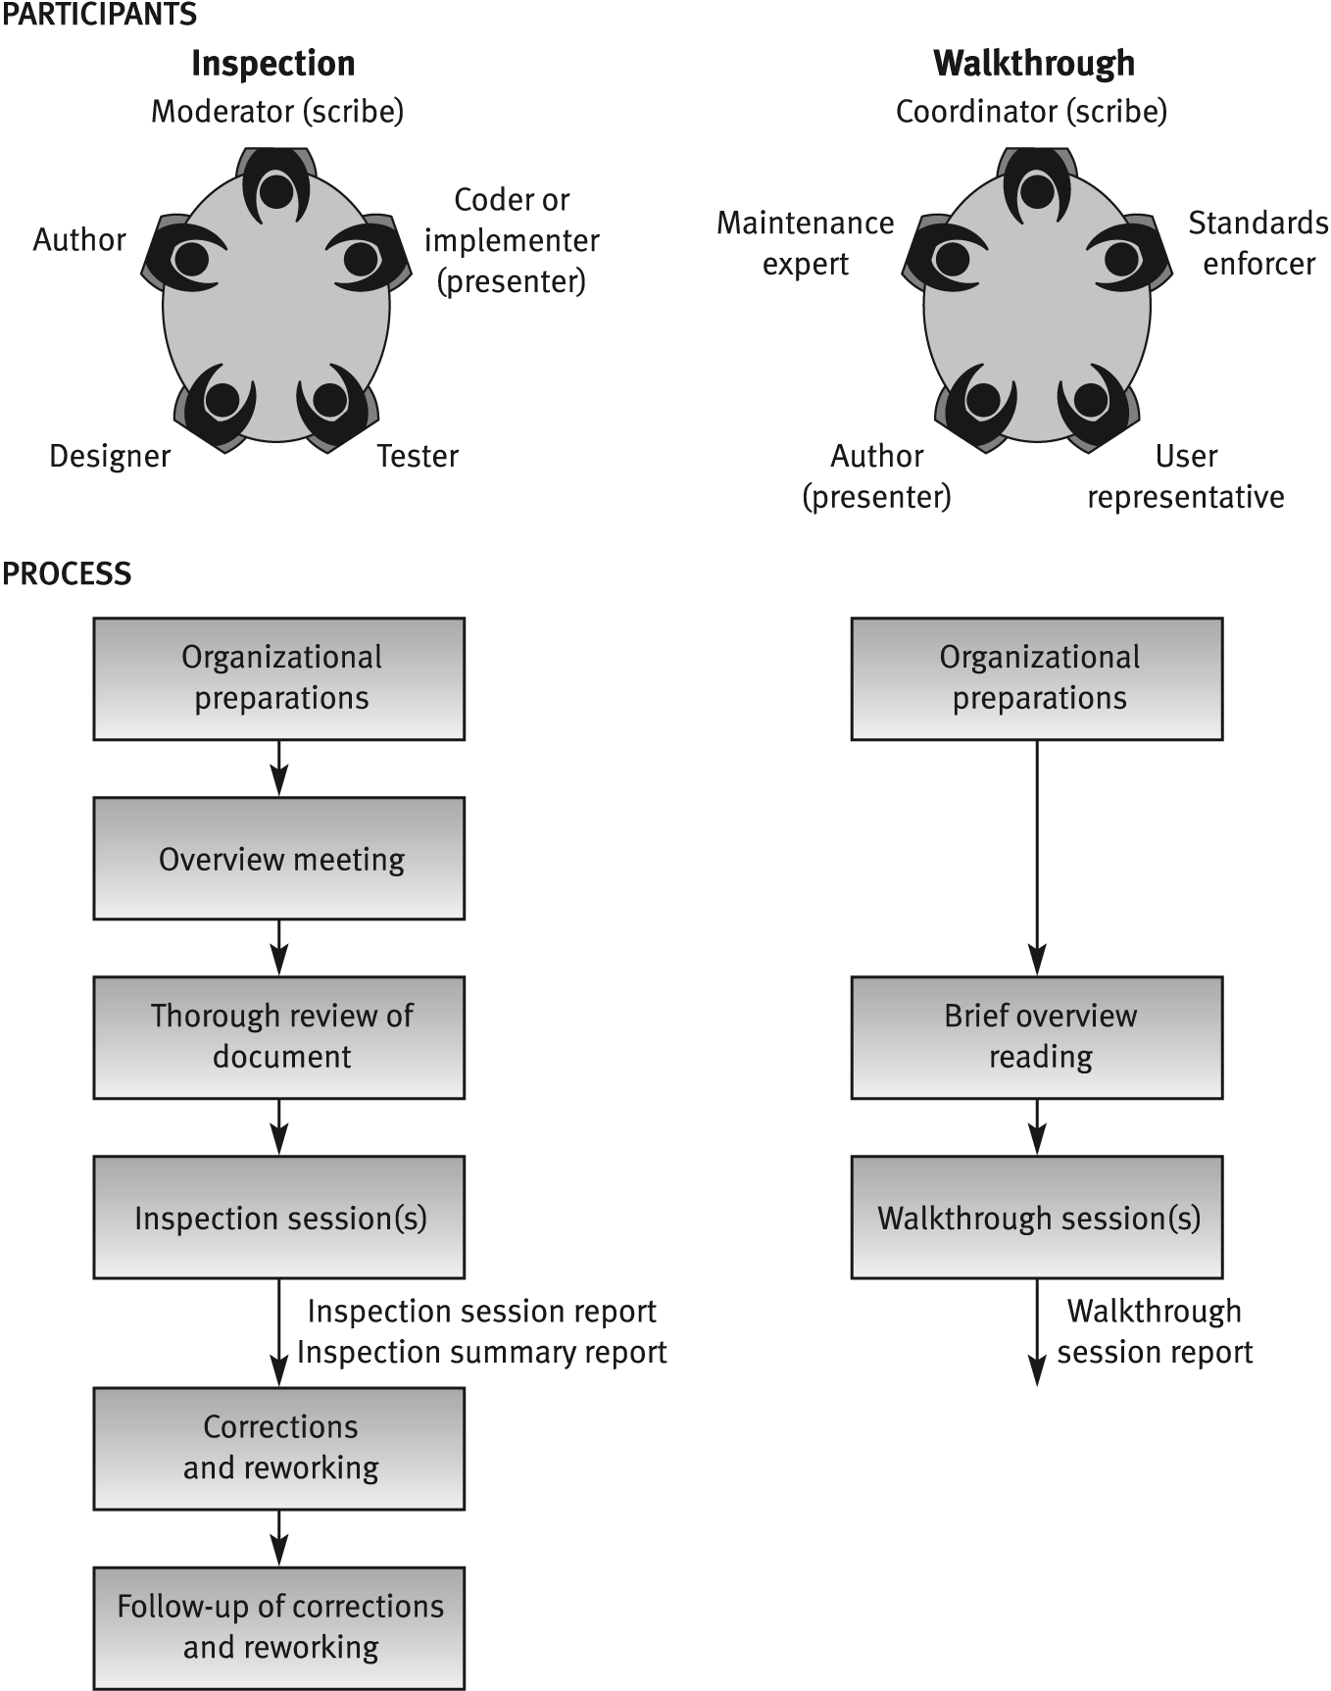
Inspection vs. Walkthrough
Note: author is
not the presenter
Much less
formal…
Author is the
presenter

Slide 12
Focus on Peer Reviews:
So for these two peer review methods, we will look at:
Participants of peer reviews
Preparation for peer reviews (some major differences)
The peer review session (presenters and emphases are different)
Post peer-review activities (differ considerably)
Peer review efficiency (arguable)
The principles that we talk about can apply to both design peer reviews and code peer reviews.

Slide 13
Participants of Peer Reviews
13
These differ by review type: inspections / walkthroughs
Inspections: (Walk-throughs - next slide)
A designer – generally the systems analyst responsible for analysis and design of software system reviewed
A coder or implementer – one who is thoroughly acquainted with coding tasks, preferably the leader of the designated coding team.
Able to detect defects leading to coding errors and other software implementation issues.
A tester – experienced professional, preferably leader of assigned testing team who focuses on identification of design errors usually detected during the testing phase.

Slide 14
Participants of Peer Reviews
14
Specialized Professionals differ by review type : walkthroughs
Walk Throughs:
A standards enforcer – team member specialized in development standards and procedures;
locate deviations from these standards and procedures. (coding standards, such as indentation, data naming, program organization, such as class content (coupling, cohesion....)
These problems substantially affect the team’s long-term effectiveness for both development and follow-on maintenance.
A maintenance expert – focus on maintainability / testability issues
to detect design defects that may hinder bug correction and impact performance of future changes. Example: refactoring expert;
A maintenance expert - Focuses also on documentation (completeness / correctness) vital for maintenance activity.
A user representation – need an internal user (if customer is in the unit) or an external representative - review’s validity due to his/her point of view as user-customer rather than the designer-supplier.

Slide 15
Preparation for a Peer Review Session
Peer review team’s preparations for review session:
For inspections: team members, preparation is quite thorough;
For walkthrough brief.
Inspection: participants must read document and list comments before inspection begins.
In overview meeting, the author provides inspection team members with the necessary background for reviewing chosen document, project in general, logic, processes, outputs, inputs, interfaces.
Tool for inspector’s review: checklist for specific documents.
For walkthroughs: team briefly reads materials for general overview of project
Generally they lack detailed knowledge and its substantive area.
In most cases, team participants not required to prepare advance comments.

Slide 16
16
Comparison of review
methodologies -
Process of review
Properties | Design review | Inspection | Walkthrough
Overview meeting | No | Yes | No
Participant’s preparations | Yes - thorough | Yes - thorough | Yes - brief
Review session | Yes | Yes | Yes
Follow-up of corrections | Yes | Yes | No
Formal training of participants | No | Yes | No
Participant’s use of checklists | No | Yes | No
Error-related data collection | Not formally required | Formally required | Not formally required
Review documentation | Formal design review report | 1) Inspection session findings report 2) Inspection session summary report

Slide 17
Software Requirements
The software requirements are description of features and functionalities of the target system. Requirements convey the expectations of users from the software product.
The requirements can be obvious or hidden, known or unknown, expected or unexpected from client’s point of view.

Slide 18
Requirement Engineering Process
Feasibility Study
Requirement Gathering
Software Requirement Specification
Software Requirement Validation

Slide 19
Software Requirement Specification (SRS)
SRS is a document created by system analyst after the requirements are collected from various stakeholders.
The requirements received from client are written in natural language. It is the responsibility of system analyst to document the requirements in technical language so that they can be comprehended and useful by the software development team.

Slide 20
Characteristics of SRS
Complete: The SRS should include all the requirements for the software system, including both functional and non-functional requirements.
Consistent: The SRS should be consistent in its use of terminology and formatting, and should be free of contradictions.
Unambiguous: The SRS should be clear and specific, and should avoid using vague or imprecise language.
Traceable: The SRS should be traceable to other documents and artifacts, such as use cases and user stories, to ensure that all requirements are being met.
Verifiable: The SRS should be verifiable, which means that the requirements can be tested and validated to ensure that they are being met.
Modifiable: The SRS should be modifiable, so that it can be updated and changed as the software development process progresses.
Prioritized: The SRS should prioritize requirements, so that the most important requirements are addressed first.

Slide 21
Characteristics of SRS
Testable: The SRS should be written in a way that allows the requirements to be tested and validated.
High-level and low-level: The SRS should provide both high-level requirements (such as overall system objectives) and low-level requirements (such as detailed functional requirements).
Relevant: The SRS should be relevant to the software system that is being developed and should not include unnecessary or irrelevant information.
Human-readable: The SRS should be written in a way that is easy for non-technical stakeholders to understand and review.
Aligned with business goals: The SRS should be aligned with the overall business goals and objectives of the organization, so that the software system meets the needs of the business.
Agile methodologies: Agile methodologies, such as Scrum and Kanban, provide an iterative approach to requirements capturing and validation, where requirements are captured and validated in small chunks of functionality and feedback is gathered from the customer.

Slide 22
Features of SRS
User Requirements are expressed in natural language.
Technical requirements are expressed in structured language, which is used inside the organization.
Design description should be written in Pseudo code.
Format of Forms and GUI screen prints.
Conditional and mathematical notations for DFDs etc.

Slide 23
Problems with SRS
If you complete the SRS (software requirements spec) before beginning the implementation, it delays the first time you can see the software running and get feedback on whether the design is a good one or not.
Most customers cannot reveal their actual requirements even under torture. The SRS may be more about what the developers think, and much less about what the customer wants.
It’s easy to miss an important stakeholder like the sales folks and not collect all the requirements.
The hardest thing to see when reviewing an SRS is a missing requirement.

Slide 24
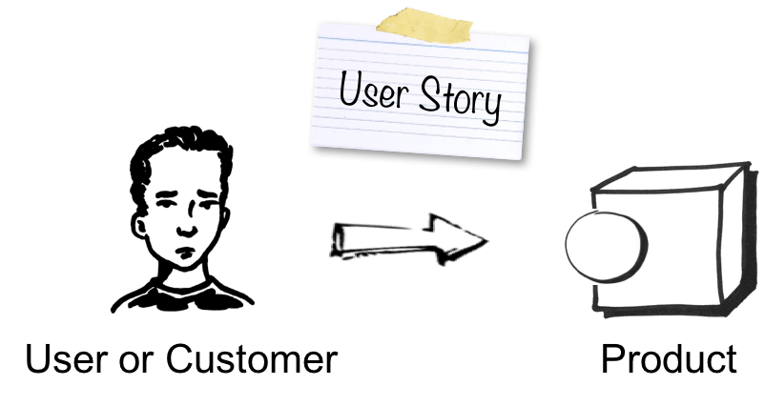
User Stories
User stories are short descriptions that focus on a specific user and what they want to achieve. User stories are placed in the SRS as a way of defining the product’s features.
User stories are part of an agile approach that helps shift the focus from writing about requirements to talking about them.

Slide 25
Format of user story
As a < type of user >, I want < some goal > so that < some reason >
As a role> I want some goal> So that some reason.
As a [customer], I want [shopping cart feature] so that [I can easily purchase items online].
As an [manager], I want to [generate a report] so that [I can understand which departments need more resources].
As a [customer], I want to [receive an SMS when the item is arrived] so that [I can go pick it up right away]
As a [bank customer], I want to [withdraw the cash with button press] so that [I can quickly conclude my session without going through a lot of menu options]

Slide 26
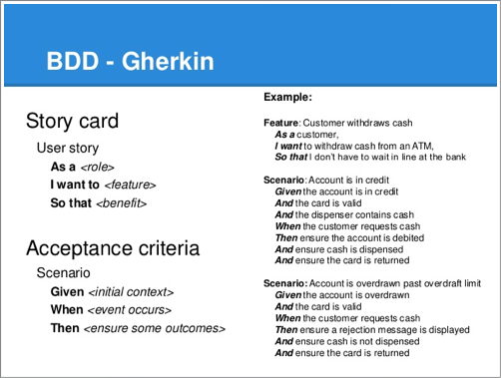

Slide 27
Major distinction between user stories and requirements
The user story focuses on the experience — what the person using the product wants to be able to do. A traditional requirement focuses on functionality — what the product should do.
User stories should be written in one or two sentences and capture who the user is, what they want, and why. A simple structure for defining features or user stories can look something like this: As a ____, I want to achieve ____ so that I realize the following benefit of ___.
Requirements tend to be very detailed and take a longer time to write. These often go into specific detail (sometimes highly technical) on how the software should work. Those details then guide the development team on how to build a new feature or functionality.
How is it written?

Slide 28
Major distinction between user stories and requirements
User stories are written throughout the building of a product. And updating the stories (or adding new ones) can happen at any time. For agile teams, the product backlog serves as a prioritized list of the functionality that needs to be developed.
Requirements also can be crafted at any time. However, it is best to define what is desired from the user standpoint first if both stories and requirement definition is required.
When are they written?

Slide 29
Major distinction between user stories and requirements
User stories can be written by just about anyone close to the software — developers raising issues, a QA tester who discovers a flaw in the UX — as long as it represents the end user’s perspective.
Requirements are written by the product manager, product owner, or business analyst. Technical leads are often involved as well as the engineers who will be responsible for working on the features or improvements.
Who writes it?

Slide 30
SELF-ASSESSMENT QUESTIONS
Define Software requirements
What are Characteristics of S/W requirements?
How the requirements can be gathered?
Criteria for good requirements gathering process

Slide 31
REFERENCES FOR FURTHER LEARNING OF THE SESSION
TEXTBOOKS:
1. Roger S.Pressman, “Software Engineering – A Practitioner’s Approach” 7th Edition, Mc Graw Hill,(2014).
2. Ian Sommerville, “Software Engineering”, Tenth Edition, Pearson Education, (2015).
3. Agile Software Development Ecosystems, Jim Highsmith, Addison Wesley; ISBN: 0201760436; 1st edition
Reference Book
Agile Modelling: Effective Practices for Extreme Programming and the Unified Process Scott Amber John Wiley & Sons; ISBN: 0471202827; 1st edition.
WEB REFERNCES/MOOCS:
https://www.digite.com/kanban/what-is-kanban/
http://www.scaledagileframework.com
https://www.guru99.com/test-driven-development.html
https://junit.org/junit5/

Slide 32

THANK YOU
Team – ADAPTIVE SOFTWARE ENGINEERING

